Slide 1

Standing Strong Against
Satanic Schemes
6:10 – 13
Week 28
14 September 2022

Slide 2

Ephesians ch6 overview
The last major section of this epistle is a call to “walk in victory,” with a charge to stand strong in the power of the Lord’s might.
Additionally, the Ephesian Christians are admonished to adorn themselves with the whole armor of God, to be able to withstand the wiles (schemes) of the devil and spiritual wickedness in heavenly places (10-13).

Slide 3

“Standing Strong Against Satanic Schemes”

Slide 4
Ephesians 6:10 – 13
When we began the Christian life, we didn’t stroll onto a happy playground . . . we stepped onto a harsh battle ground. Though we don’t hear bombs bursting in the distance or bullets whizzing past our ears, we live every day of our lives on a spiritual battlefield.
Make no mistake, Satan’s snipers have us in their crosshairs. They know us intimately. Having studied us for years, they are familiar with our strengths and fully aware of our weaknesses. They know their prey far better than we know our devilish predators.

Slide 5
Ephesians 6:10 – 13
Whether you’re a young believer or a seasoned saint, spiritually strong or weak, well trained or just a novice, Satan and his emissaries have one goal for you: destruction.
Their one great hope is not simply to cripple you but to decimate you. Though their own ultimate doom is certain, they intend to bring down as many with them as they can. Paul writes what he does because he wants to keep us standing firm in our faith to the very end.
Paul assures his readers that, even in the hail of artillery fire that continually rains down upon us, we can be safe from Satan’s schemes. But we can’t do it on our own. We who have received new life through Christ must live that new life by the power of the Spirit.

Slide 6
Ephesians 6:10 – 11
¹⁰Finally, be strong in the Lord and in his mighty power. ¹¹Put on the full armor of God, so that you can take your stand against the devil’s schemes.

Slide 7
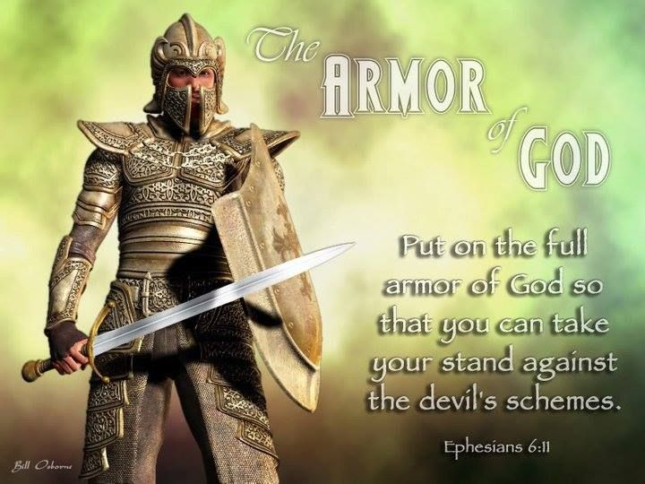

Slide 8
Ephesians 6:10 – 11
Paul’s spiritual battle cry rings out in 6:10. Think of it as his call to arms—a bugle blast meant to awaken us from passivity and alert us to the realities of the conflict.
Paul urges us to “be strong in the Lord.” Only through His strength will we be able to stand and fight in this ongoing spiritual conflict.
Satan would like nothing better than for us to picture him as the little red imp on our shoulder, whispering naughty ideas into our ears. As long as we think of him as a pesky little pest that we can brush away like a mosquito, we won’t realize just how insidious he is.

Slide 9
Ephesians 6:10 – 11
Pay attention to the nature of the arsenal with which we believers have been supplied: “the strength of His might” (6:10). The reality is that in our own strength, we are no match for Satan or any of his wicked minions. Only when we rely on Christ’s strength can we hope to defeat such a deceptive and destructive foe.
This doesn’t mean that God the Son and Satan are equal and opposite beings. Far from it! The Bible teaches that Satan is an angelic creature of God (Ezek 28:12-16) who can do nothing apart from God’s control or permission (Job 1:16-12; Luke 22:31). Satan is not the counterpart of God but of the archangel Michael (Jude1:9; Rev 12:7).

Slide 10
Ephesians 6:10 – 11
Satan is also the enemy and accurse of humans (Zech 3:1-2; 1Peter 5:8). While we must not deny that Satan has the power to attack and ensnare us (Eph 4:27; 1Tim 3:7), we also must not attribute to Satan more power than he actually has.
Reflecting back on Paul’s prayer at the beginning of this letter, he asked that believers might know “the surpassing greatness of His power” which is “in accordance with the working of the strength of His might” (Eph 1:19). Now we see why. This is not mere head knowledge. In fact, it even goes beyond what people call “heart knowledge.” The knowledge Paul had in mind was personal and practical knowledge—a learned awareness of God’s strength, a knowledge gained by spiritual victory in the mist of battle.

Slide 11
Ephesians 6:10 – 11
Our enemy is strong, and his attacks are relentless, but the power of Christ can defend us against any assault of Satan.
Continuing his summon to battle, Paul instructs the Ephesians on how to employ God’s strength: “Put on the whole (full) armor of God, so that you will be able to stand firm against the schemes of the devil” (6:11). Because we fight a spiritual battle, only spiritual armor can protect us.
Observe that this isn’t your armor—it’s God’s armor. You can’t provide it for yourself. You can’t muster up enough mental, emotional, or physical strength to fight a spiritual battle. It’s utterly impossible. Since the enemy is spiritual, you and I need spiritual armor.

Slide 12
Ephesians 6:10 – 11
We’ll discuss the details of this armor in the next lesson. For now it’s sufficient to point out that Paul is not referring to literal armor that a believer places on his or her body.
Paul is likening God’s spiritual power and protection of His people to a common sight of his day—the full protective gear and offensive weaponry of a Roman soldier.
Remember, Paul wrote Ephesians while under house arrest, guarded by a Roman soldier (Acts 38:16, 20). For an illustration of God’s protection, Paul could have simply looked out his window.
In the rest of this section, we’ll take a closer look at two facets related to the armor of God: (1) the reason we need the armor (6:12) and (2) the effect of wearing it (6:11, 13).

Slide 13
Ephesians 6:12 – 13
¹²For our struggle is not against flesh and blood, but against the rulers, against the authorities, against the powers of this dark world and against the spiritual forces of evil in the heavenly realms. ¹³Therefore put on the full armor of God, so that when the day of evil comes, you may be able to stand your ground, and after you have done everything, to stand.

Slide 14
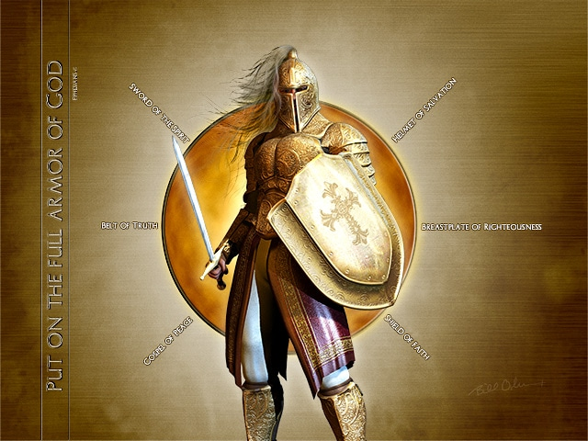

Slide 15
Ephesians 6:12 – 13
THE REASON WE NEED THE ARMOR (6:12). Paul paints a dark and foreboding picture of the world in which we live, highlighting three reasons we desperately need God’s supernatural protection.
FIRST – Satan and his demons are not “flesh and blood” (6:12); they are spiritual beings. As such, their presence and power cannot be detected through our five senses. Rather, they must be discerned spiritual. This puts us at a distinct disadvantage from the start.
Ever since the Fall, we humans have been pulled toward this physical world, focused only on what we can see, feel, hear, taste, and smell. However, to do battle with Satan, we need to set aside our worldly wisdom and empirical approach to life.

Slide 16
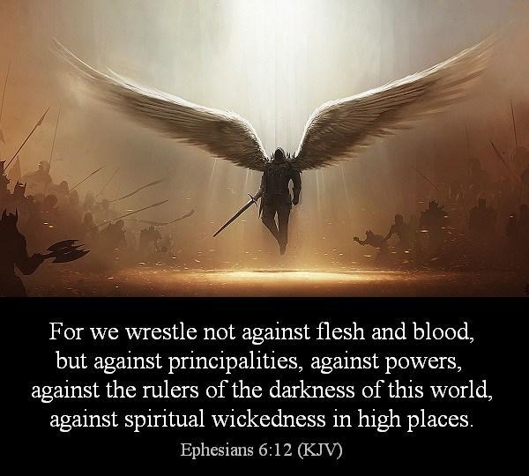

Slide 17
Ephesians 6:12 – 13
Instead of relying on our own wisdom and experimental approach to life, we must open our eyes of faith, and trust that what God says about the spiritual realm is more real than the ever-changing “realities” of this present tangible world.
SECOND – We struggle against an organized hierarchy of demonic rulers, powers, and forces of wickedness. Think of this as the spiritual Mafia. But let’s be sensible here. Some have made Paul’s ranking of demons in Ephesians 6:12 walk on all fours. They concoct complex descriptions of specific kinds of demons who rule over precise areas of the world.

Slide 18
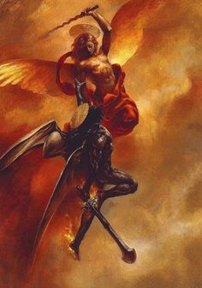
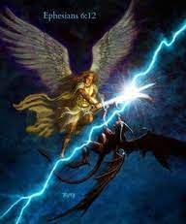

Slide 19
Ephesians 6:12 – 13
It’s best, however, to see Paul as referring to some kind of ordered evil ambition in the demonic ranks without feeling obligated to create an organizational chart of the demonic realm. Not only is such a tight organization impossible to discern in Scripture—it’s not necessary. God can win His war against Satan regardless of how well organized he and his demons might be.
THIRD – This force of evil is characterized by unparalleled wickedness. Swindoll cites Kent Hughes who said it best in two sentences from his book on Ephesians: “Satan has no conscience, no compassion, no remorse, no morals. He feeds on pain and anguish and filth.”

Slide 20
Ephesians 6:12 – 13
Few villains in Hollywood adequately portray the depths of pure evil that exist in Satan and his demonic mob. Frankly, human beings can’t fully relate to the total wickedness that motivates the devil.
It seems like every bad guy in literature, television, or film has some kind of potential for redemption, a limit to his or her wickedness, or at least a reasonable explanation for his or her evil behavior that can almost prompt pity.
Yet when it comes to Satan, there is no possibility of redemption, no limit to his evil except what is placed on him by God’s sovereign restraint, and no rational explanation or motivation for what he seeks to do.

Slide 21

Ephesians 6:12 – 13
Perhaps the villain known simply as the Joker in Christopher Nolan’s 2008 Batman sequel, The Dark Knight, reflects to some degree the kind of senseless depravity that characterizes our satanic foe: “Some men aren’t looking for anything logical . . . .They can’t be bought, bullied, reasoned, or negotiated with. Some men just want to watch the world burn.”
We see proof of this depravity in our world every day. Violent crime, devastating wars, religious deception, moral deterioration, political corruption—the list has no end. We don’t even have to turn on the television or surf the Internet to se the results of satanic wickedness. We merely need to look within and around as we observe the sin . . .

Slide 22
Ephesians 6:12 – 13
The sin of disharmony, selfishness, and corruption in our own marriages, families, neighborhoods, and churches. Taking advantage of humanity’s fallen nature, the forces of evil can lead the unwary and unprotected believer away from the right path and into a path of destruction.
Swindoll quoting John Stott > “Wobbly Christian who have no firm foothold in Christ are an easy prey for the devil. And Christians who shake like reeds and rushes cannot resist the wind when the principalities and powers begin to blow. Paul wants to see Christians so strong and stable that they remain firm even against the devil’s wiles and even in the evil day, or in a time of special pressure. For such stability, both of character and in crisis, the armor of God is essential.”

Slide 23
Ephesians 6:12 – 13
THE EFFECTS OF WEARING THE ARMOR (6:11, 13). We’ve seen the reason we need the armor of God (6:12). Now let’s consider the results of having God’s supernatural protection. For this, let’s look at 6:11 and 6:13 together: they complement each other.
In 6:11, Paul tells us to “put on the full armor of God.” In 6:13, he picks up this same idea after explaining why this armor is essential: “take up the full armor of God.” The effects of wearing this armor are also described in both verses: “so that you will be able to stand firm against the schemes of the devil . . . So that you will be able to resist in the evil day, and having done everything, to stand firm.”

Slide 24


Slide 25
Ephesians 6:12 – 13
FIRST – The effects of wearing God’s armor enables us “to stand firm.” We have a fearsome enemy, but because we’re protected by God’s power, we have no reason to tremble at his temptations or quake at his threats. We don’t need to cower in terror or run in panic.
In Christ, our victory is certain. The outcome of the battle has been determined. It is true that our “adversary, the devil, prowls around like a roaring lion, seeking someone to devour” (1Peter 5:8), but when we resist him with God’s strength, he flees our presence like a frightened cockroach scurrying from the light (cf. James 4:7 > “Submit yourselves therefore to God. Resist the devil, and he will flee from you”).

Slide 26


Slide 27
Ephesians 6:12 – 13
SECOND – The effects of wearing God’s armor is the ability “to discern the devil’s schemes” (6:11). The Greek word for “schemes” is the same word Paul uses in Ephesians 4:14 “craftiness in deceitful scheming.”
The word is plural, indicating that Satan has numerous—no doubt countless—devices in his arsenal for undermining our spiritual progress. Though the devil is damned, depraved, and defeated, he is no dummy. He can identify, target, and exploit your weaknesses and the chinks in your man-made defenses before you’re even aware of them yourself. Having God’s armor can help protect us from these devastating assaults.

Slide 28


Slide 29
Ephesians 6:12 – 13
THIRD – The effects of wearing God’s armor is the ability “to resist in the evil day” (6:13). The phrase “the evil day” probably refers to both general spiritual oppression in our present time and special attacks by wicked spirits against us.
Swindoll quoting Harold Hoehner > “The believers should be aware that they must be prepared, not only for everyday evils but for the times of heightened and unexpected spiritual battles. For example, when the devil failed to tempt Jesus to sin, he left Jesus until an opportune time” (Luke 4:13).

Slide 30
Ephesians 6:12 – 13
If Satan tempted the unimpeachable Son of God at “opportune” times, we can be sure his gang of demonic thugs will do the same to us. But when we stand firm in the provision of strength and promise of protection we have through Jesus Christ, Satan will slink away in defeat.
We have glimpsed Satan’s diabolical plan and learned of God’s indispensable protection. Let’s consider three principles concerning spiritual warfare that we can apply personally to our lives.
FIRST – No satanic assault is stronger than God. Satan’s forces are indeed powerful. But if you can’t go to sleep tonight because you’re afraid, or if you suddenly wake up in cold sweat for fear of Satan’s schemes, then you’ve missed the message. This is not about being afraid.

Slide 31
Ephesians 6:12 – 13
This is about standing strong in the provision of Jesus Christ. Nothing is stronger than the Spirit of God living within us, empowering us to avoid deception, overcome temptation, and stand firm through satanic or demonic attacks.
First John 4:4 promises, “Great is He who is in you than he who is in the world.” So here’s the question: Do you have the Spirit of God dwelling within you? Have you experienced the new birth by grace alone through faith alone in Christ alone?
Only those who have been born again into God’s family can stand on the side of the One who is Greater than all spiritual enemies.

Slide 32
Ephesians 6:12 – 13
SECOND – No satanic scheme can penetrate God’s armor. Without that protection, we’re exposed to every assault, every arrow, every bombardment by the enemy. Yet when we are “born again to a living hope,” we are also “protected by the power of God through faith” (1Peter 1:3, 5).
The gospel hymn writer puts it well: “Leaning, leaning, safe and secure from all alarms; Leaning, leaning, leaning on the everlasting arms.”
If you’re a believer, are you leaning on your own temporal defenses? Or have you fully thrown yourself into the protective arms of the Savior? Have you been trying to unravel Satan’s schemes and repel his attacks by your own wisdom , methods, and righteous works? Or are you surrendering to Christ as your Advocate and Defender.

Slide 33
Ephesians 6:12 – 13
THIRD – No satanic evil can prevail over God’s church. Around AD 110, in a letter to the very same church in Ephesus as Paul’s prison epistle, the famous preacher, teacher, and martyr Ignatius of Antioch described quite dramatically the corporate aspect of spiritual warfare.
No doubt aware of Paul’s own rousing passage on spiritual warfare, Ignatius wrote to the church at Ephesus, “Make every effort to come together more frequently to give thanks and glory to God. For when you meet together frequently, the powers of Satan are overthrown and his destructiveness is nullified by the unanimity of your faith.”

Slide 34
Ephesians 6:12 – 13
One thing is clear in Paul’s letter to the Ephesians: We can’t “go it alone.” We weren’t meant to. Just as the Holy Spirit dwells within each of us individually (1Cor 6:19), he also dwells within the gathered community—the Church Body (1Cor 3:16-17; Eph 2:21-22).
So, do you want to be prepared for spiritual attack and to stand firm in the protection of God? Then stay close to God’s people. Draw strength from their presence and encouragement (Heb 10:23-25).

Slide 35



Slide 36
NEXT CLASS – 21 September 2022
Book of Ephesians
Before next class, read the below verses in the NIV and in one other versions of the Bible, i.e., NKJV, NRSV, KJV, CEV, etc …
Chapter 6:14 – 20
“Ample Armor for Weak Warriors”

